Slide 1

Artificial Intelligence
Introduction

Slide 2

Instructor
Anish Raj
Assistant Professor
Computer Engineering and I.T.
 anishraj.comp@coep.ac.in
 7276626277

Slide 3
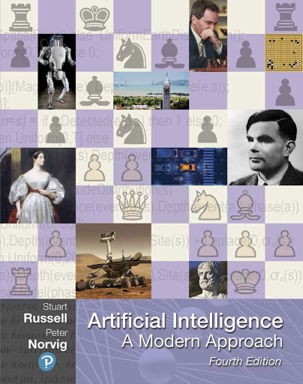
Course Information
Sessions:
Work:
Homework
20+20+60 = 100 marks
Relative grading scale
Prerequisites:
Computer Basics:
Data Structure
Algorithm
There will be some
math
logic
Programming (python/java/C++)
http://aima.cs.berkeley.edu/
Notes:
new modality, new lecturer, new edition, new timing! Lost >2 hours of class time.

Slide 4
Exam Dates
Midterm: No
Final: Second week of August (probably)

Slide 5
Policies
For online lectures:
Camera and mic off
Please do ask questions: “Hand Up” or write in Chat
We (staff) are here to help
Please do observe academic integrity policies!
Please don’t exclude your fellow students!

Slide 6
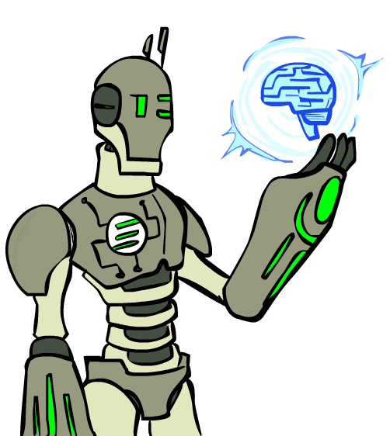
Today
Artificial intelligence in Movies, News?
Past: how did the ideas in AI come about?
Present: what is the state of the art?
Future: will robots take over the world?

Slide 7
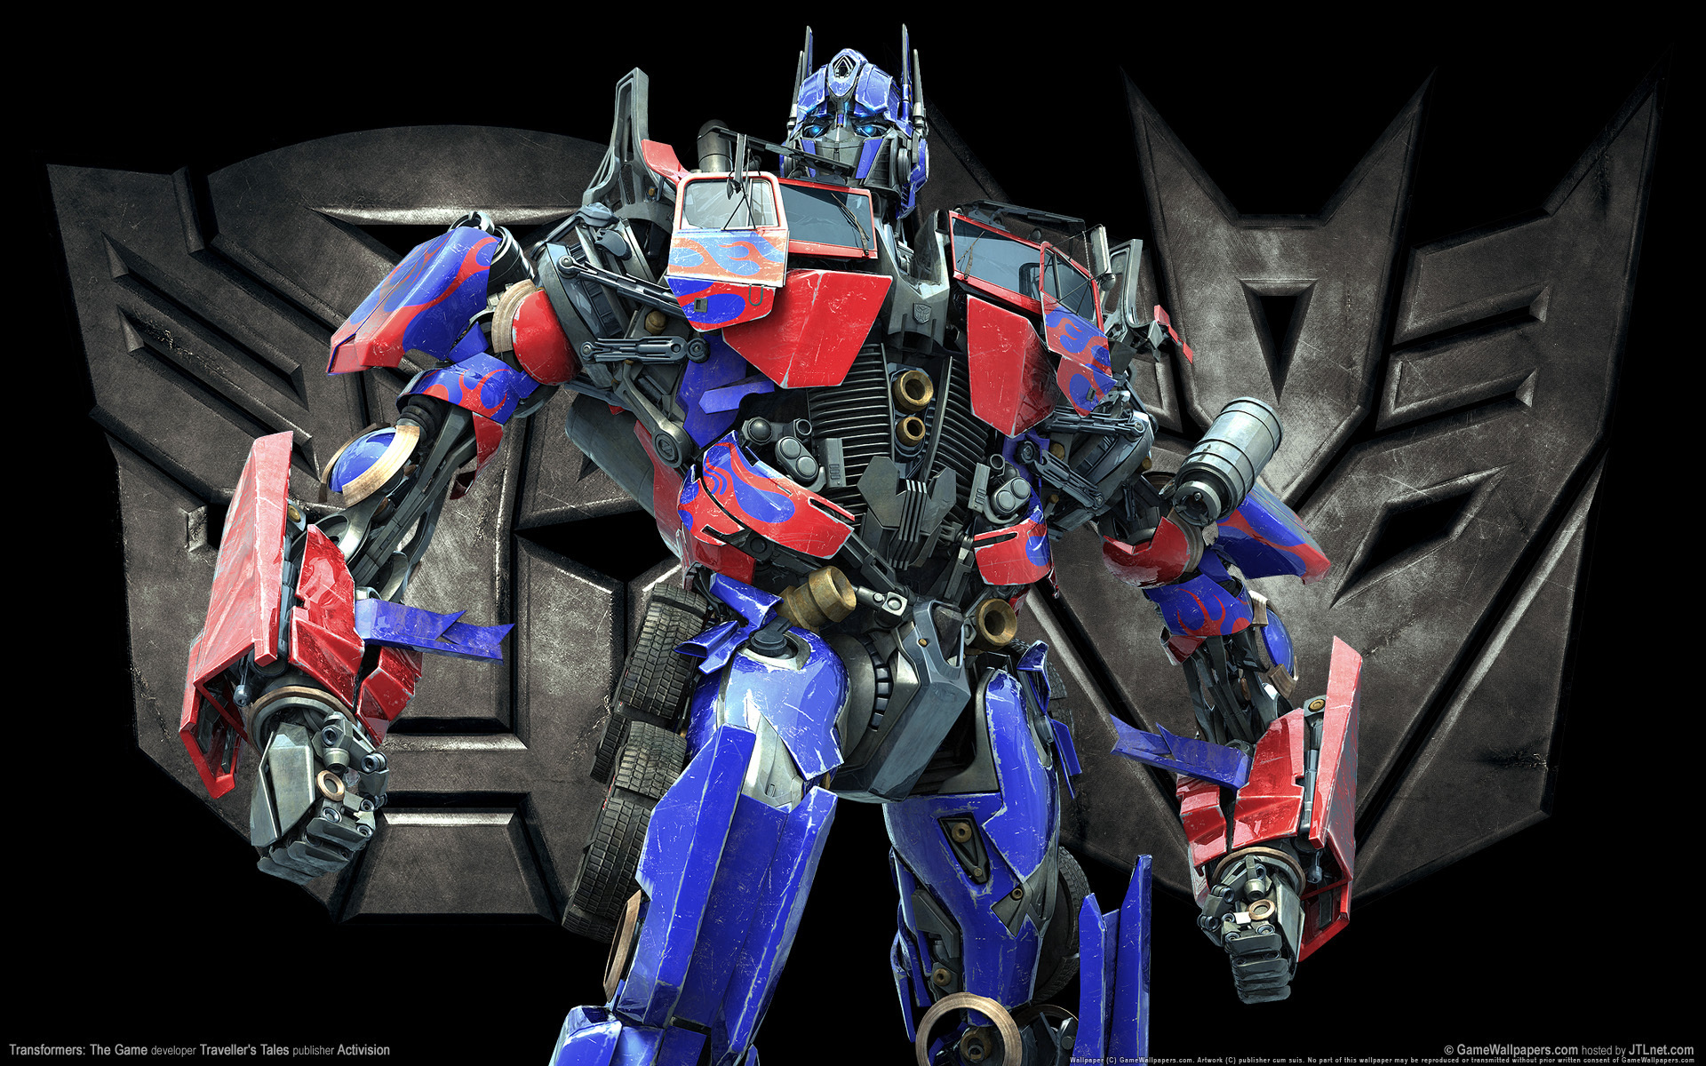
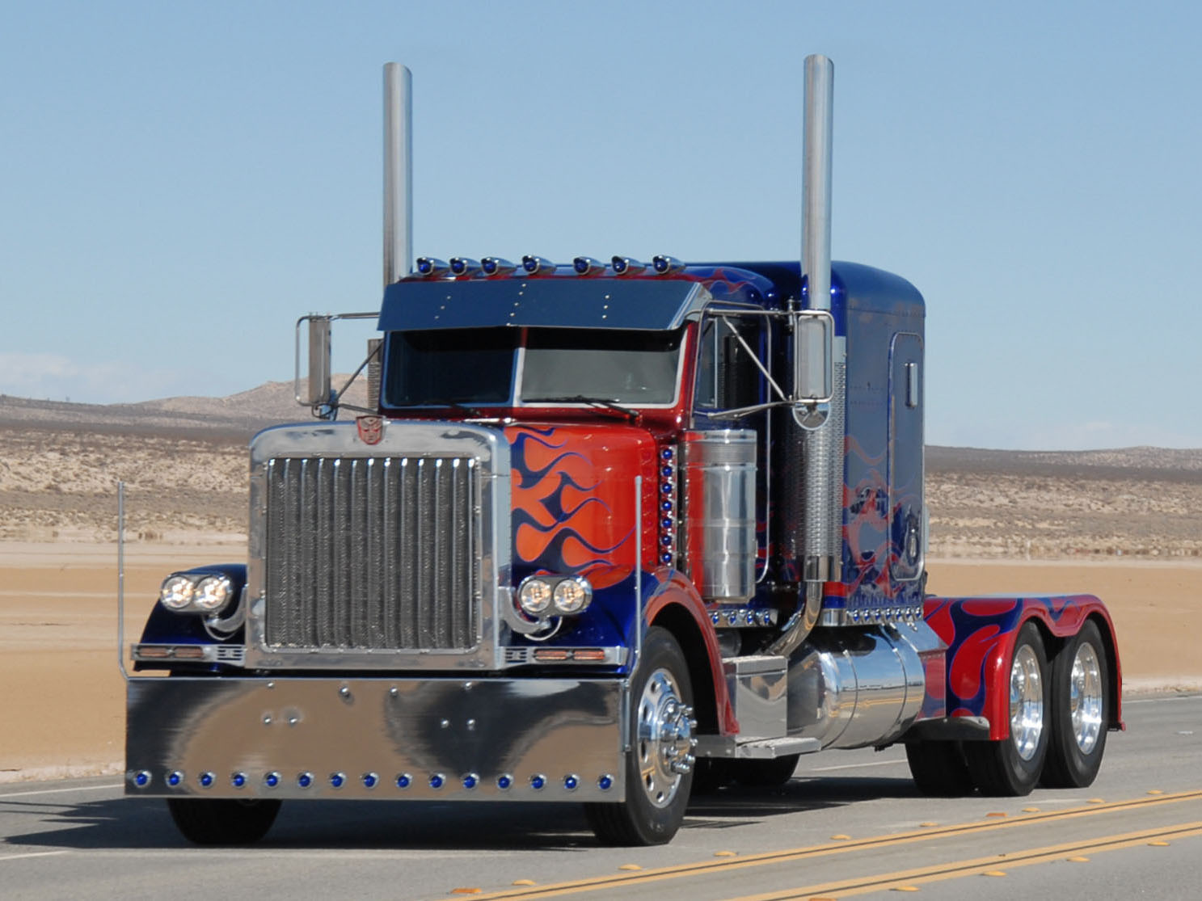
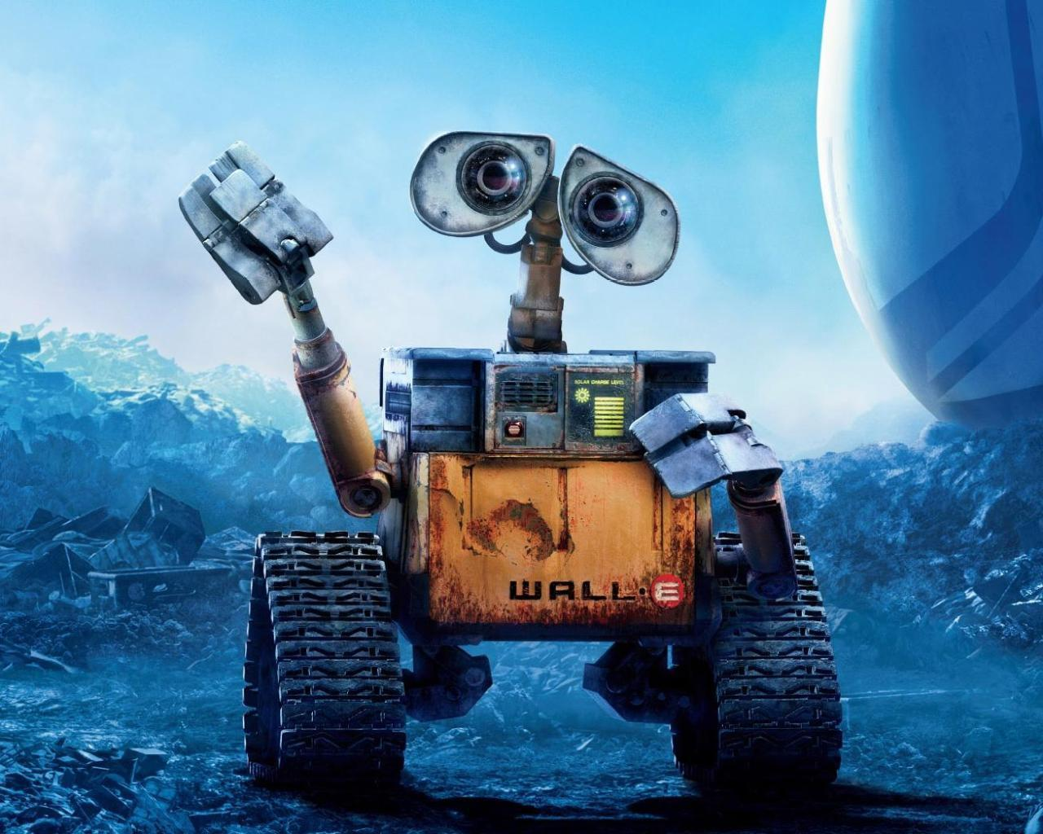
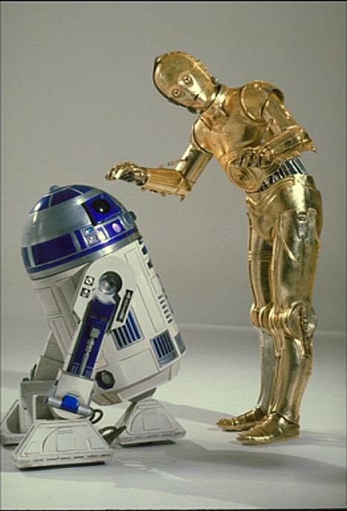


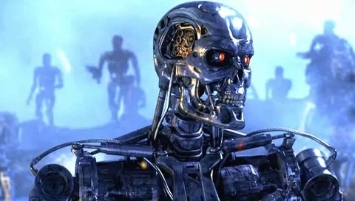
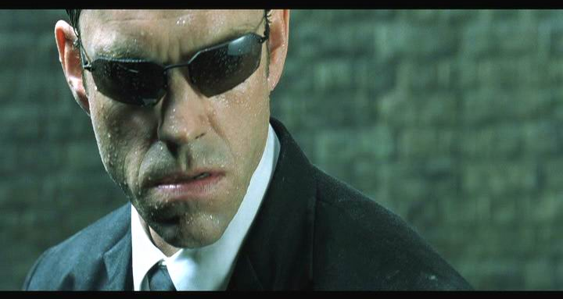
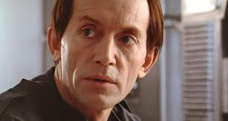
Movie AI
Notes:
You can type into chat when you recognize the robot (just once!)
C3PO, what does he do? Essentially google translate, (but with anxiety disorder!)
R2D2 – what does he do, yeah, not so sure
These are all good

Slide 8
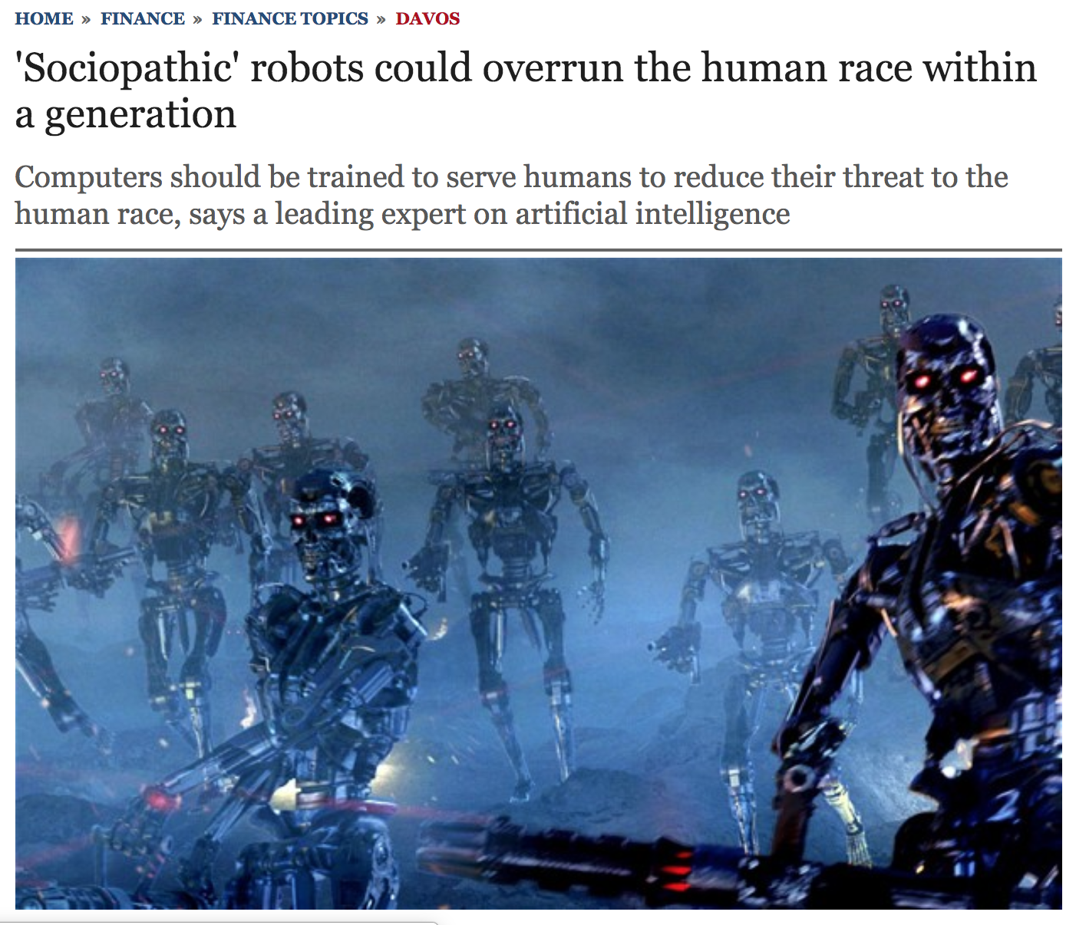
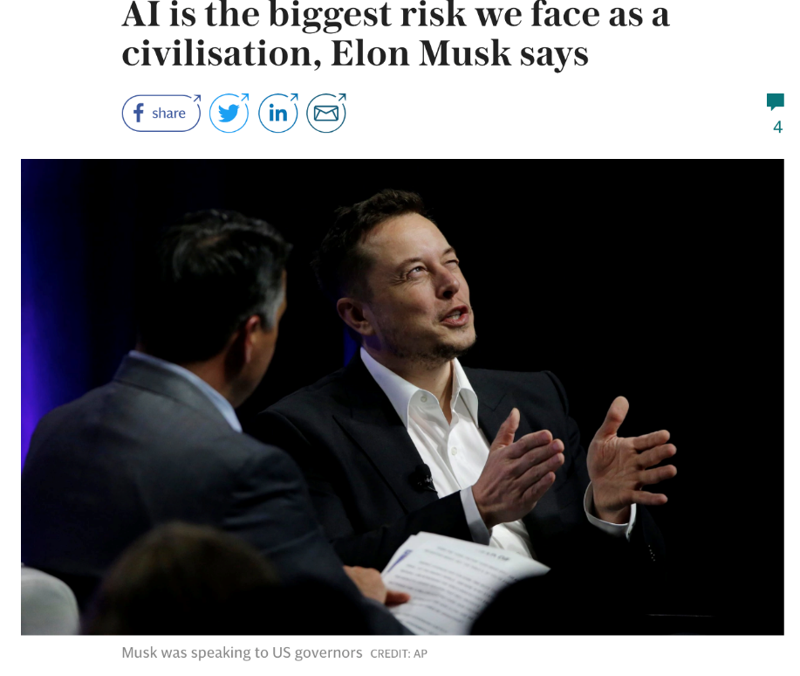
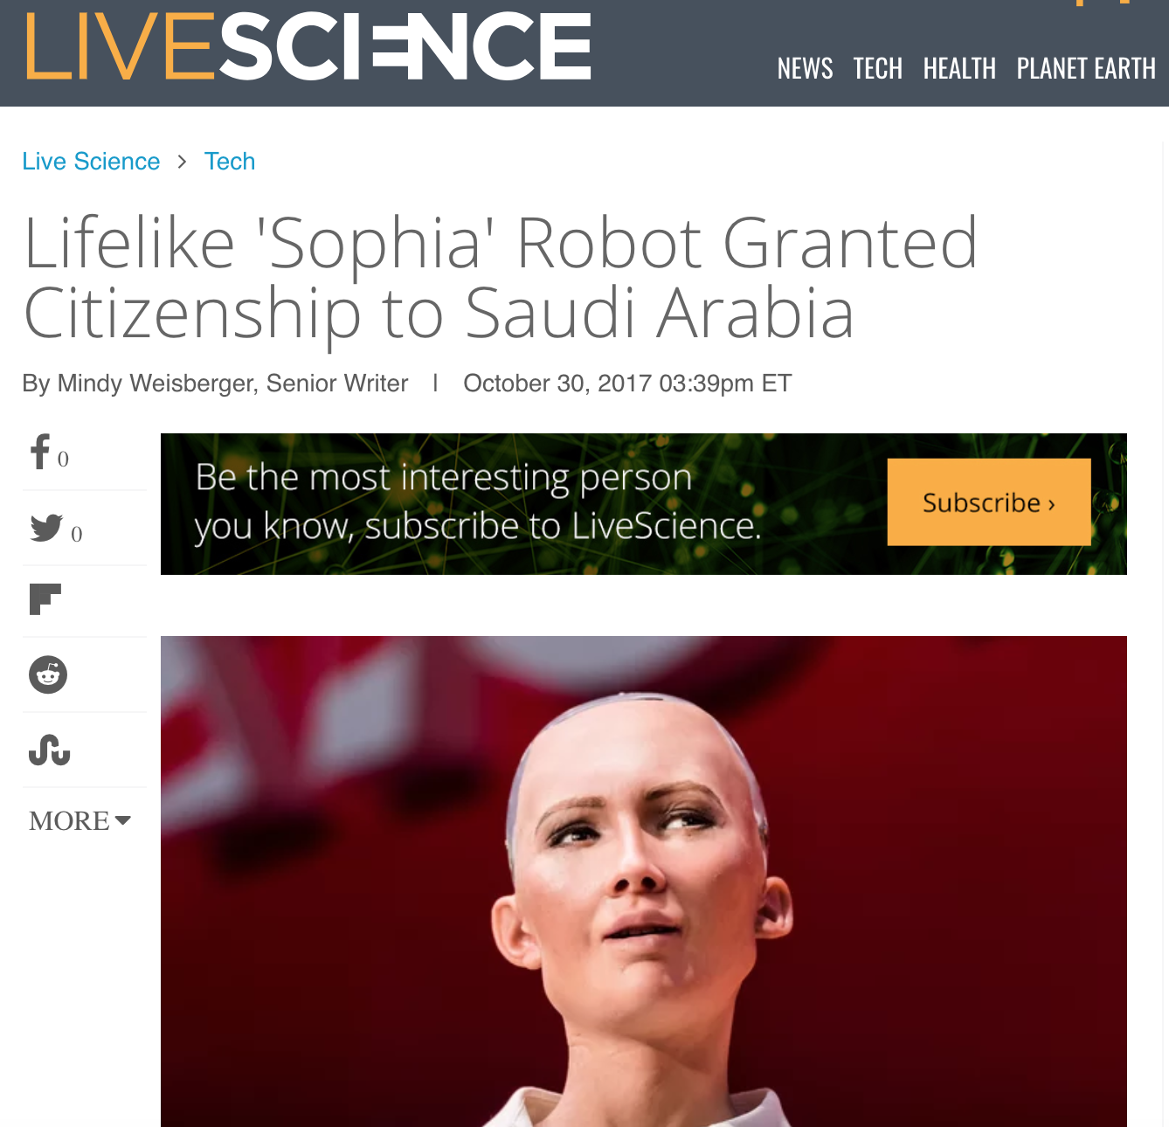

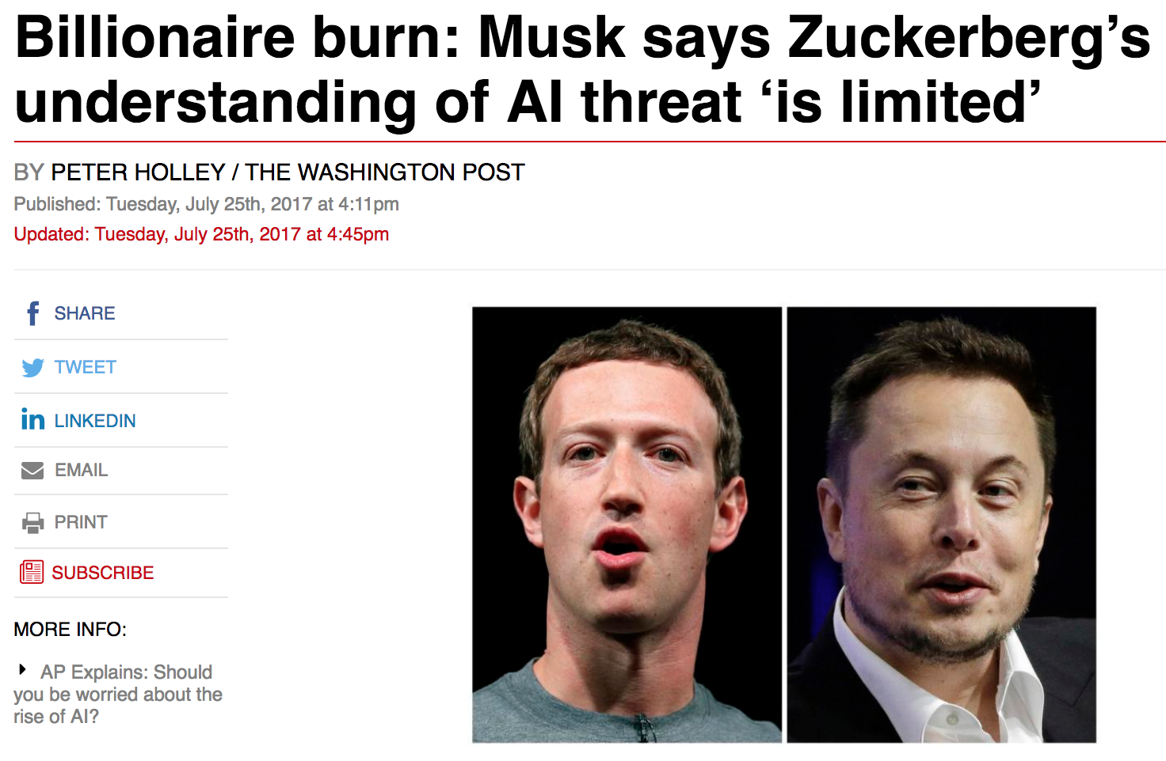
News AI

Slide 9

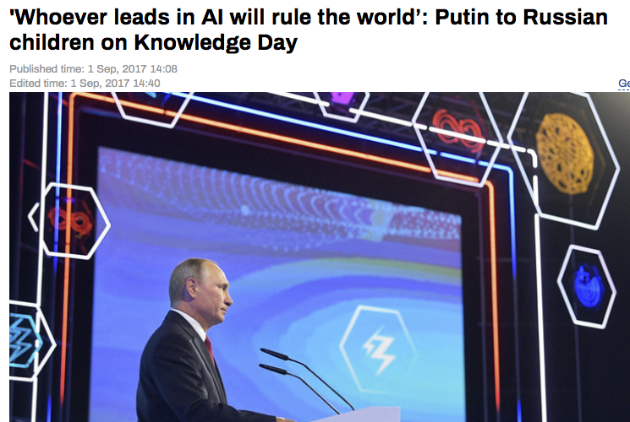
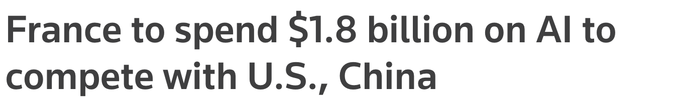
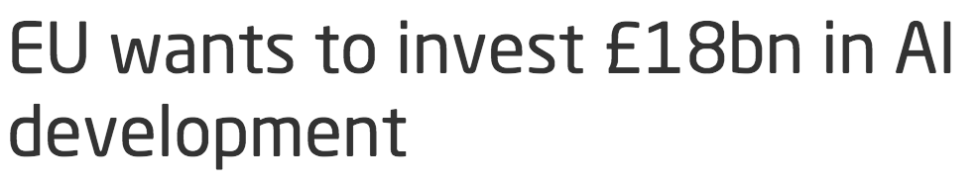

News AI

Slide 10
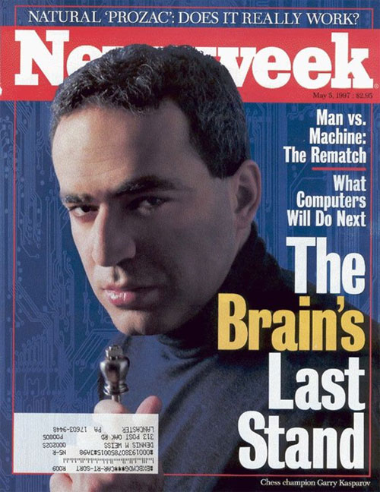
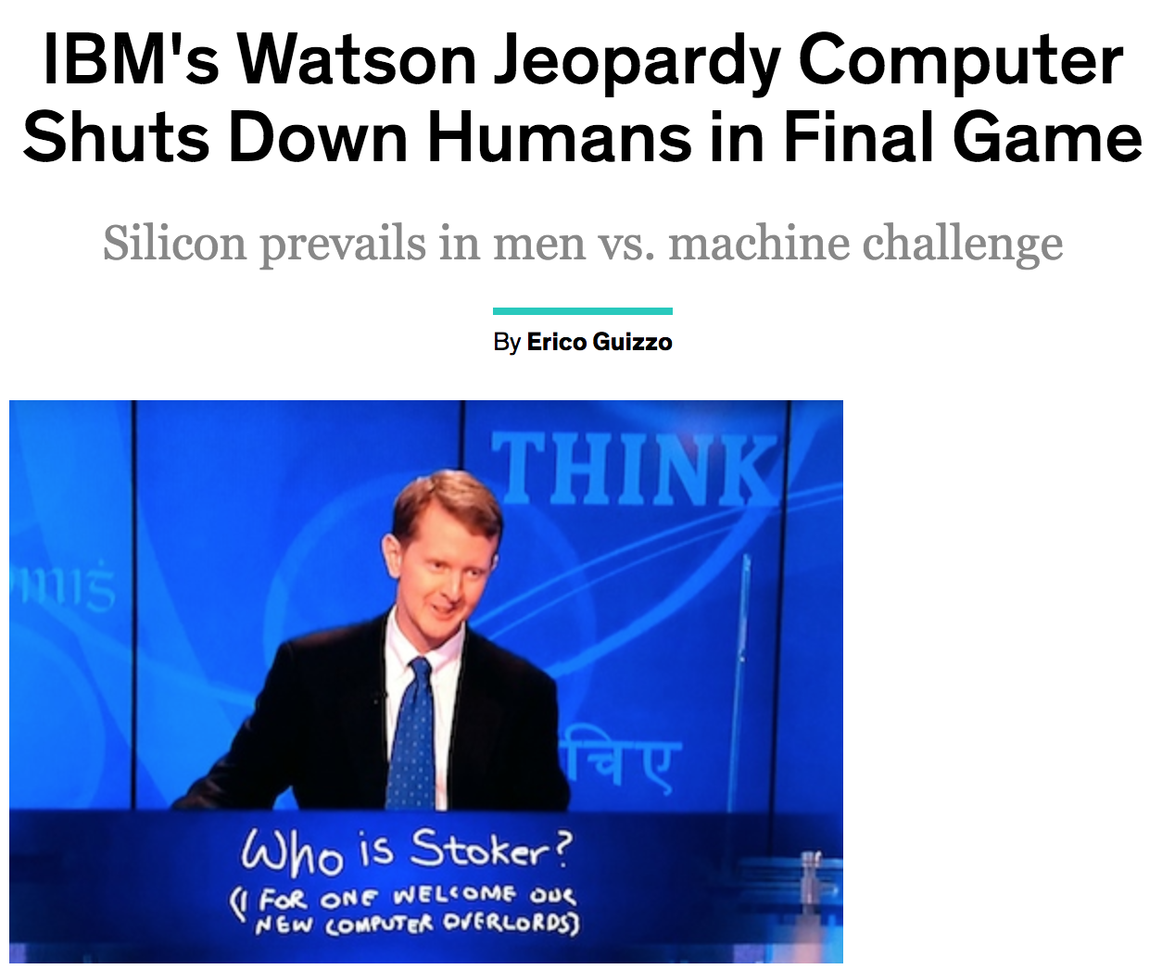

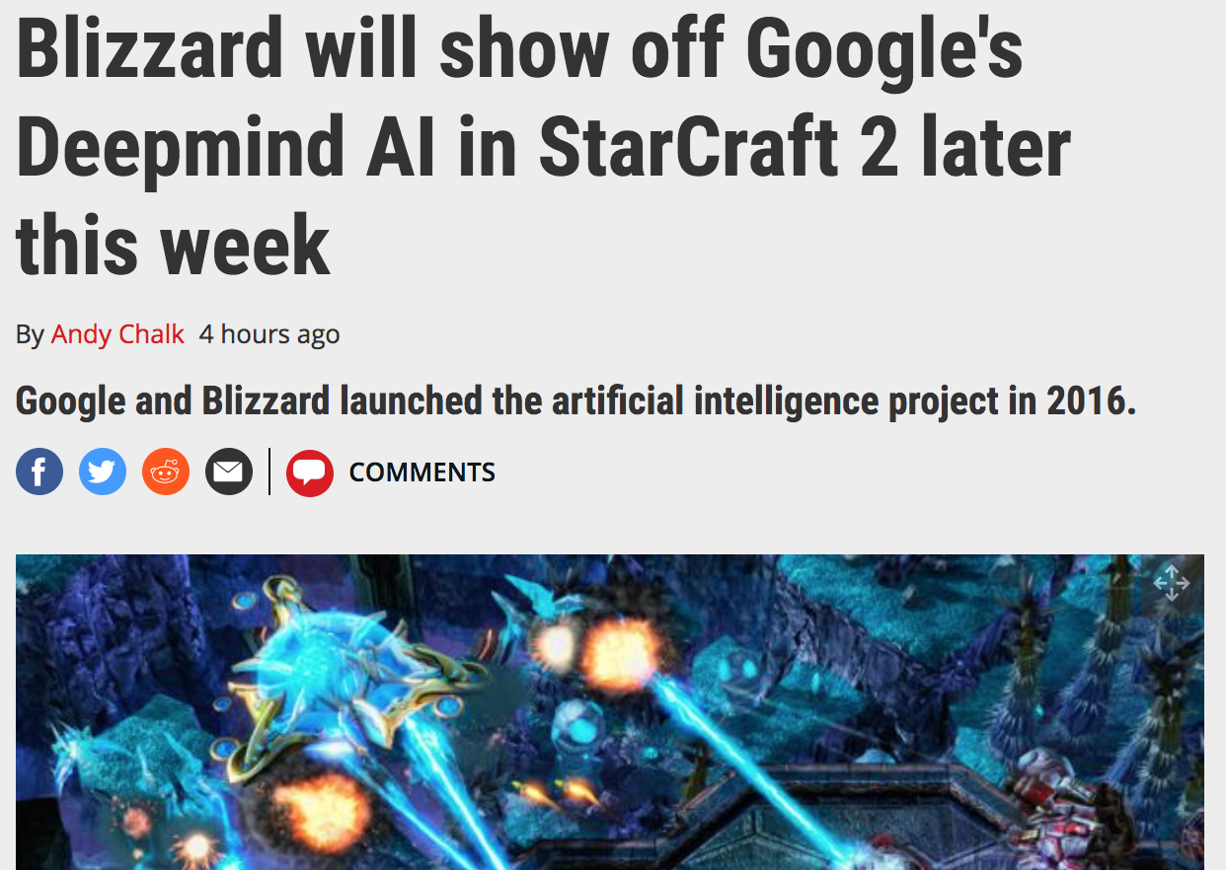
News AI

Slide 11
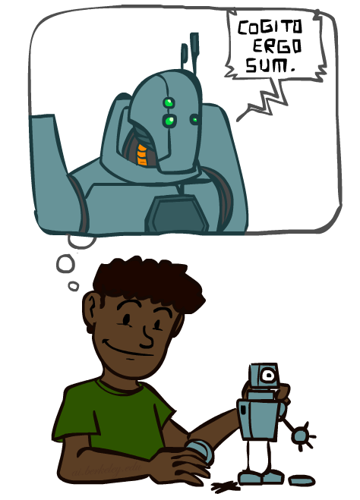
A (Short) History of AI

Slide 12
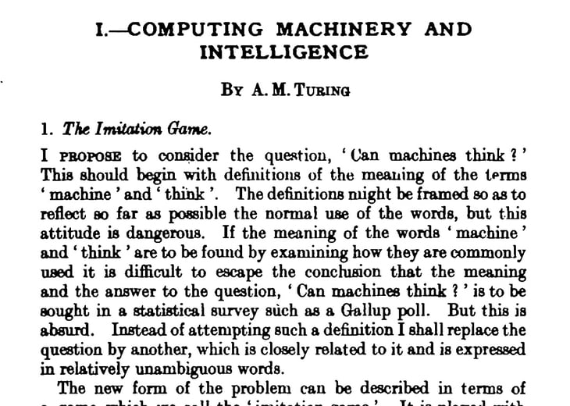
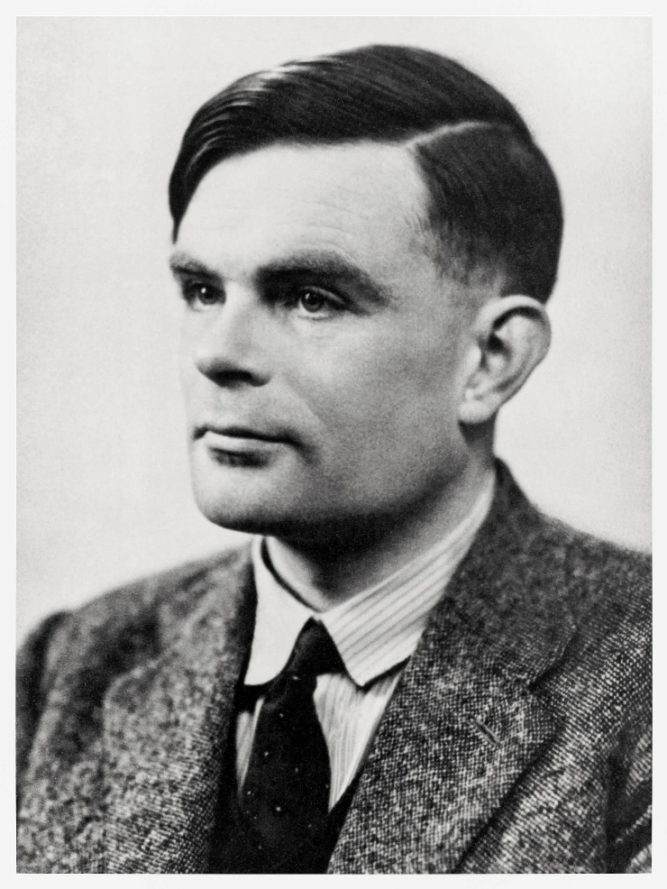
Alan Mathison Turing

Slide 13
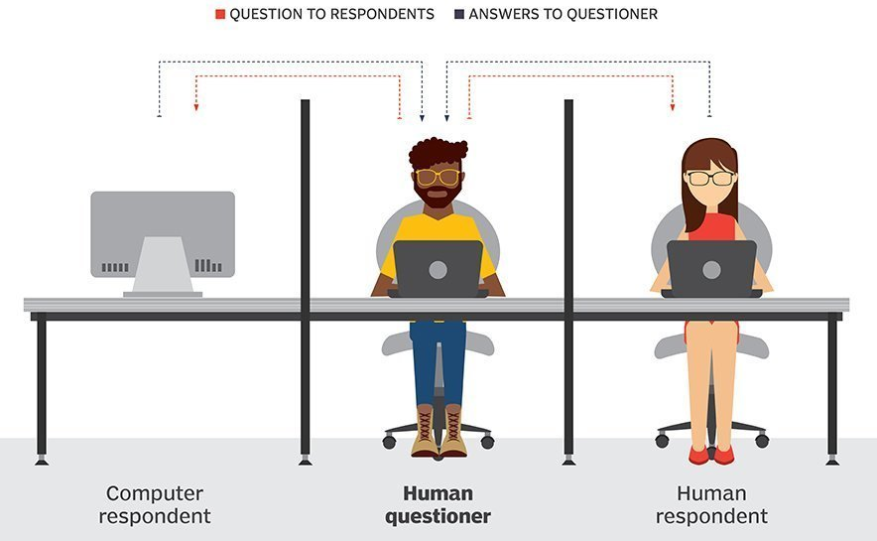
Turing Test

Slide 14
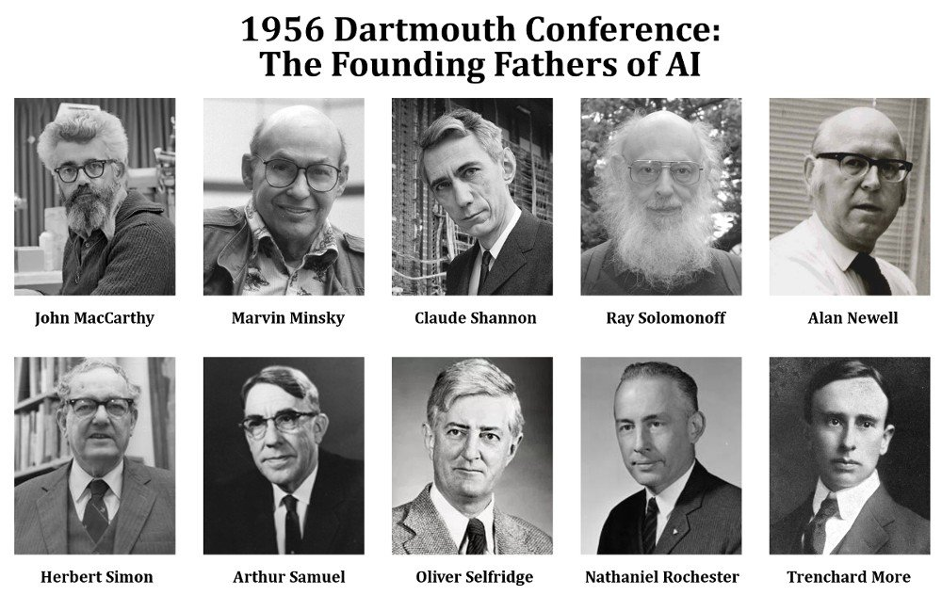

Slide 15
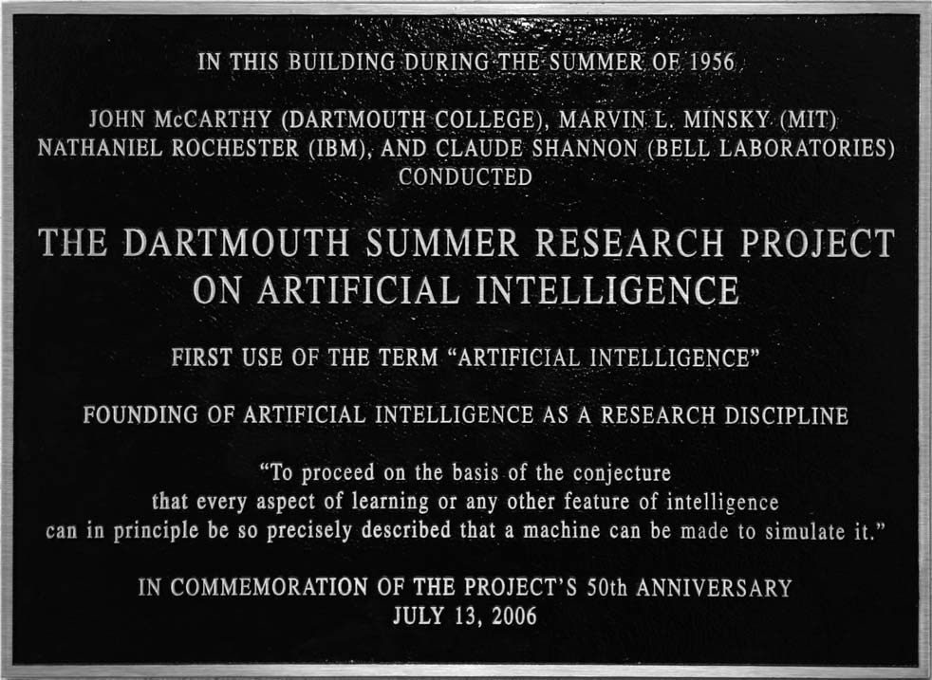

AI’s official birth: Dartmouth, 1956

Slide 16
AI’s official birth: Dartmouth, 1956
“An attempt will be made to find how to make machines use language, form abstractions and concepts, solve kinds of problems now reserved for humans, and improve themselves. We think that a significant advance can be made if we work on it together for a summer.”

Slide 17
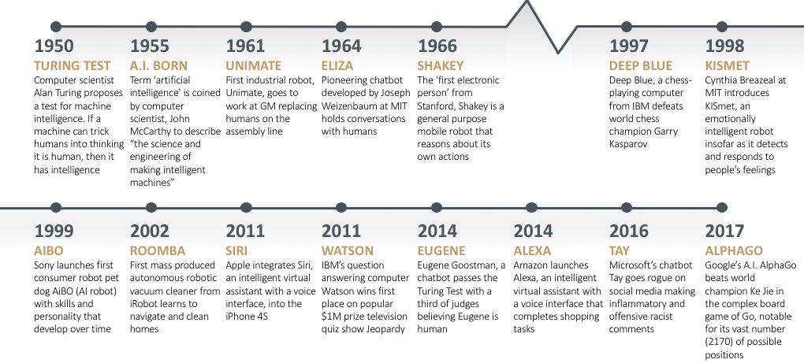
AI is not NEW

Slide 18
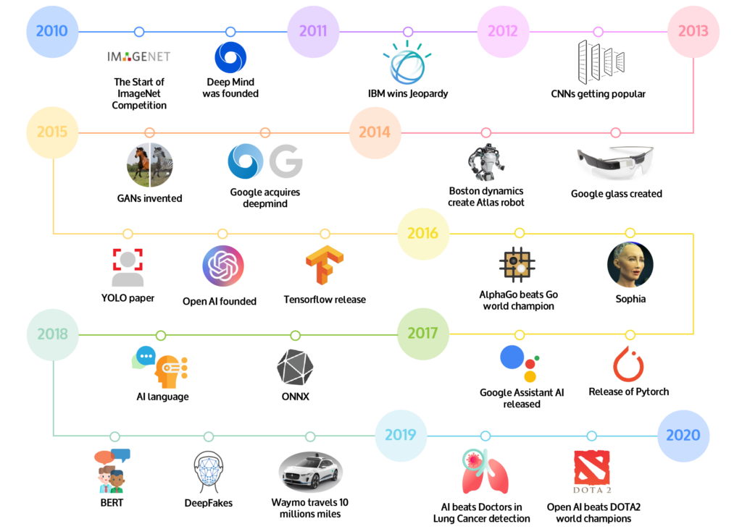
In last Decade

Slide 19
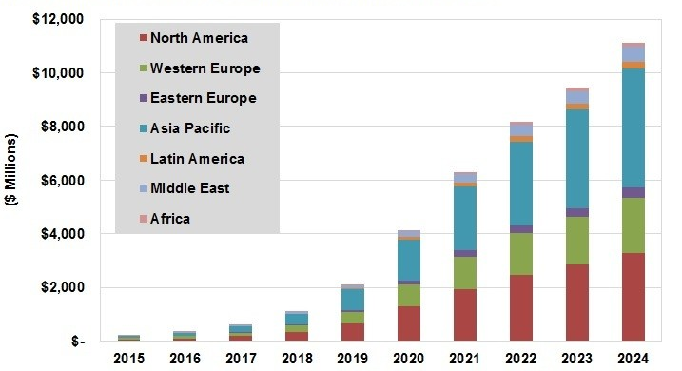
AI Revenue by Region, World Bank Report 2017

Slide 20
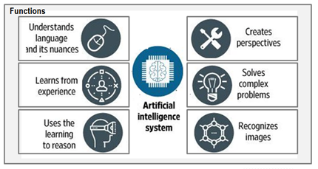
Artificial Intelligence System

Slide 21
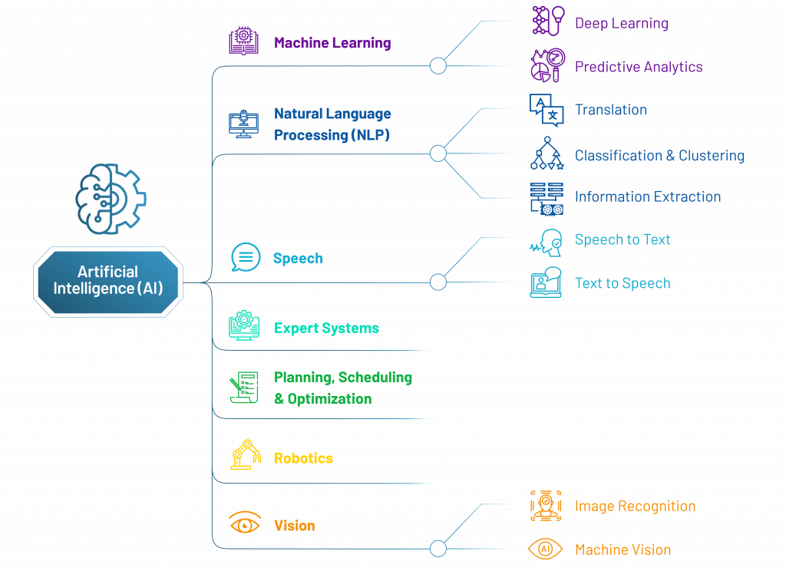
Artificial Intelligence System Task

Slide 22
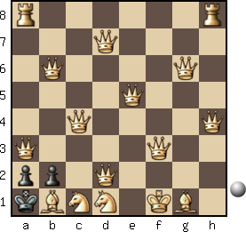

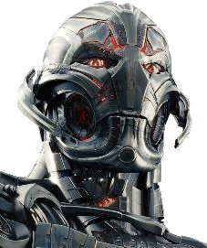
Artificial Intelligence System Types
Artificial Narrow Intelligence (ANI):
Machine intelligence that equals or exceeds human intelligence or efficiency at a specific task
Siri, Alexa.
Artificial General Intelligence (AGI):
A machine with the ability to apply intelligence to any problem, rather than just one specific problem (human-level intelligence)
Advanced Robotics
Artificial Super Intelligence (ASI):
An intellect that is much smarter than the best human brains in practically every field, including scientific creativity, general wisdom and social skills
→ One specific task
ANI: Chess Program
→ Many things like a human
AGI: Human Level
→ More than what a human can
ASI: Superintelligence

Slide 23
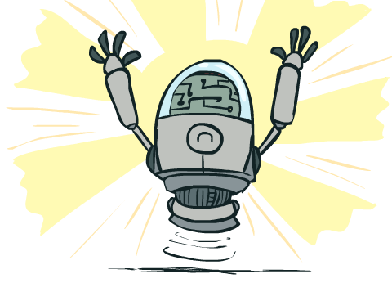
What Can AI Do?
Quiz: Which of the following can be done at present?
Play a decent game of table tennis?
Play a decent game of Jeopardy?
Drive safely along a curving mountain road?
Drive safely along Lakshmi Road?
Buy a week's worth of groceries on the web?
Buy a week's worth of groceries at Tulsi Bag?
Discover and prove a new mathematical theorem?
Converse successfully with another person for an hour?
Perform a surgical operation?
Translate spoken Chinese into spoken English in real time?
Fold the laundry and put away the dishes?
Write an intentionally funny story?
Notes:
Mountain road example: https://www.wired.com/2010/11/audis-robotic-car-climbs-pikes-peak/

Slide 24
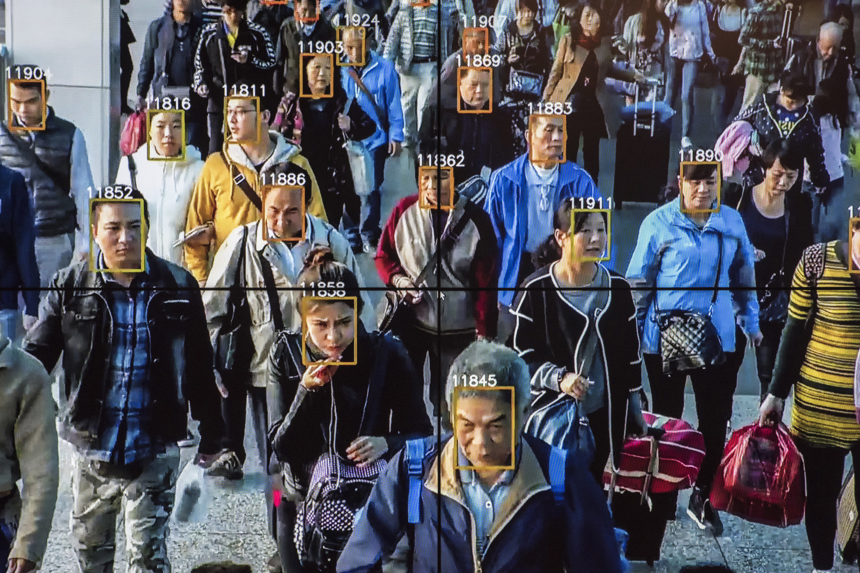
Real AI

Slide 25
Notes:
Robots help nurses in hospitals deliver stuff to different rooms

Slide 26
Notes:
Or drones that record cooll videos of us as we do outdoor activities
Or in my case,

Slide 27
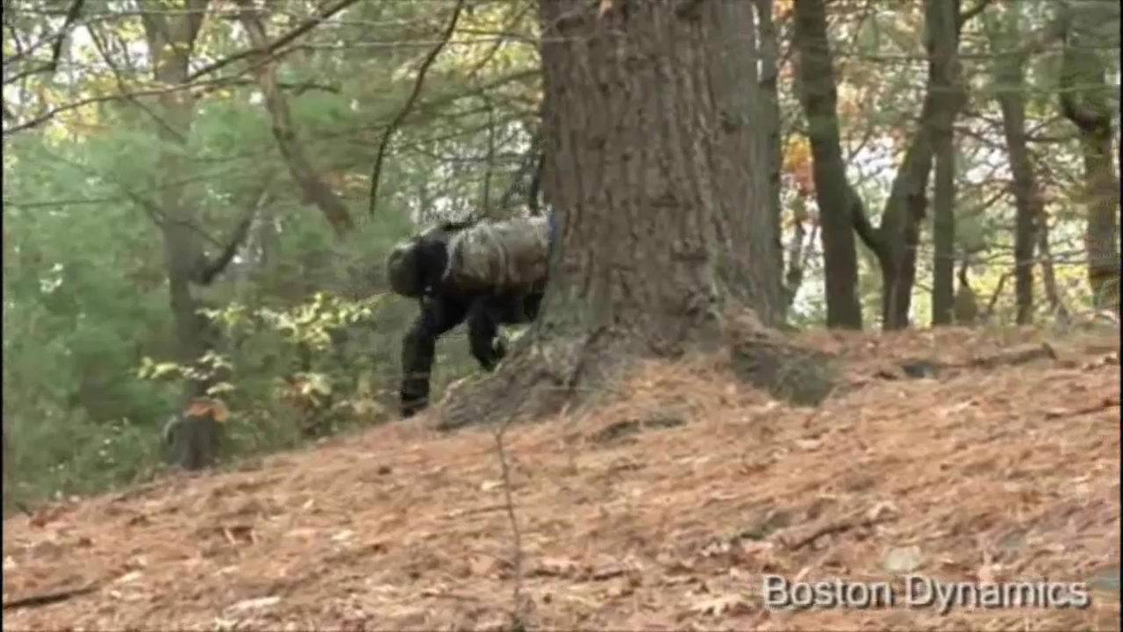

Slide 28
Notes:
Robots look like this. We have autonomous cars that figure out how to take us to our destination
28

Slide 29
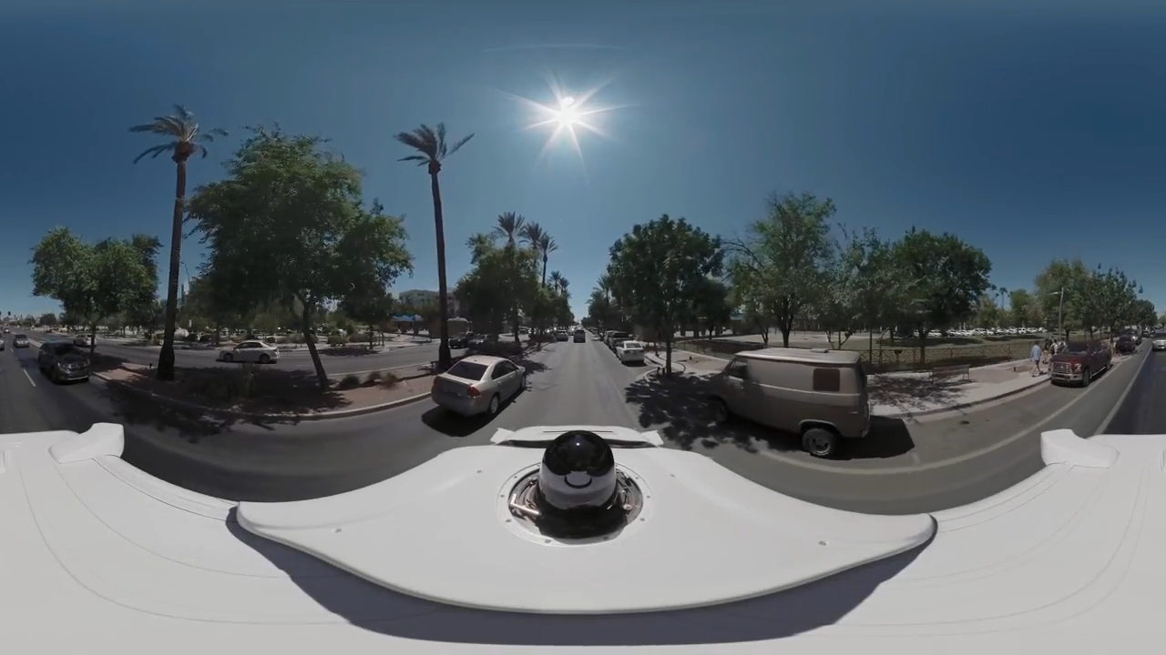

Slide 30
Future
We are doing AI…
To create intelligent systems
The more intelligent, the better
To gain a better understanding of human intelligence
To magnify those benefits that flow from it
E.g., net present value of human-level AI ≥ $13,500T
Might help us avoid war and ecological catastrophes, achieve immortality and expand throughout the universe
What if we succeed?

Slide 31
It seems probable that once the machine thinking method had started, it would not take long to outstrip our feeble powers. … At some stage therefore we should have to expect the machines to take control

Slide 32
What’s bad about better AI?
AI that is incredibly good at achieving something other than what we really want
AI, economics, statistics, operations research, control theory all assume utility to be fixed, known, and exogenously specified
Machines are intelligent to the extent that their actions can be expected to achieve their objectives
Machines are beneficial to the extent that their actions can be expected to achieve our objectives

Slide 33
A new model for AI
1. The machine’s only objective is to maximize the realization of human preferences
2. The robot is initially uncertain about what those preferences are
3. Human behavior provides evidence about human preferences
The standard model of AI is a special case, where the human can exactly and correctly program the objective into the machine

Slide 34
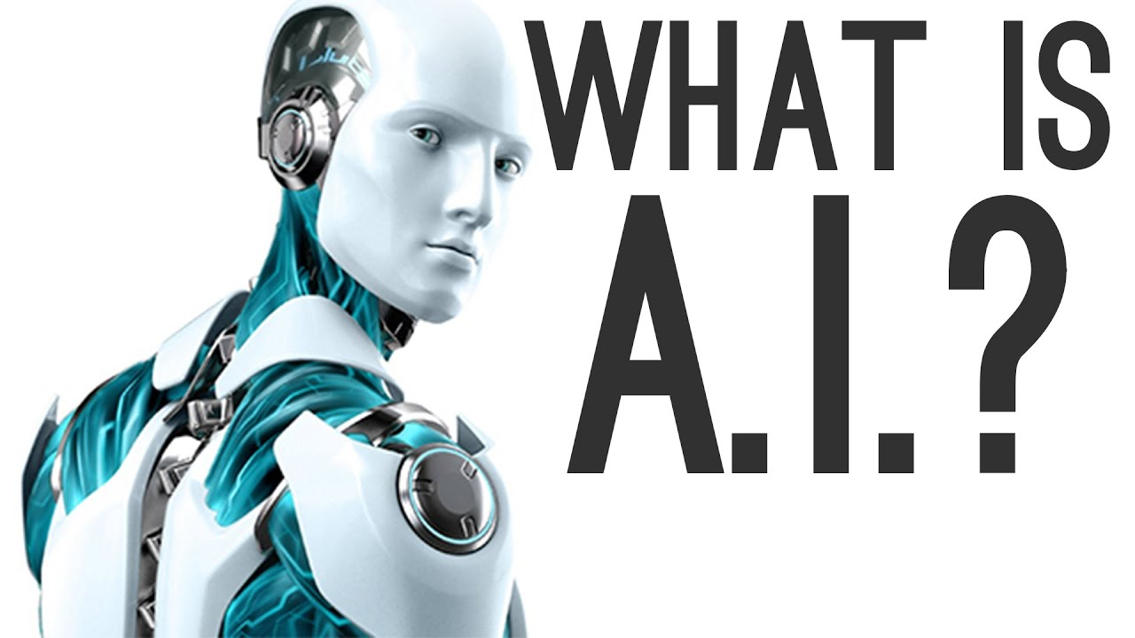

Slide 35
What is Artificial Intelligence?
There is no clear consensus on the definition of AI
John McCarthy coined the phrase AI in 1956
Q. What is artificial intelligence?
It is the science and engineering of making intelligent machines, especially intelligent computer programs. It is related to the similar task of using computers to understand human or other intelligence, but AI does not have to confine itself to methods that are biologically observable.
Q. Yes, but what is intelligence?
Intelligence is the computational part of the ability to achieve goals in the world. Varying kinds and degrees of intelligence occur in people, many animals and some machines.

Slide 36
Other Definition
Definition | Researcher | Year
Automation of activities that we associate with human thinking, activities such as decision making, problem solving, learning. | Bellman | 1978
The study of mental faculties through the use of computational models | Charniak & McDertmott | 1985
Artificial Intelligence is the study of how to make computer do things which, at the moment, people do better | Rich & Knight | 1991
The branch of computer science that is concerned with the automation of intelligent behavior | Luger & Stubblefield | 1993

Slide 37
Dimensions of AI
 | Human-like vs. Rational
Thought vs. Behavior | Automation of activities that we associate with human thinking, activities such as decision making, problem solving, learning…” (Bellman 1978) | “The study of mental faculties through the use of computational models” (Charniak & McDertmott 1985)
 | Artificial Intelligence is the study of how to make computer do things which, at the moment, people do better. (Rich & Knight 1991) | “The branch of computer science that is concerned with the automation of intelligent behavior” (Luger & Stubblefield 1993)

Slide 38
Dimensions of AI
 | Human-like vs. Rational
Thought vs. Behavior | Systems that think like humans | Systems that think rationally
 | Systems that act like humans | Systems that act rationally

Slide 39
Dimensions of AI
 | Human-like vs. Rational
Thought vs. Behavior | Systems that think like humans (Model human cognition) | Systems that think rationally (Formalized inference process)
 | Systems that act like humans (Exhibits the human behavior) | Systems that act rationally (Doing the right thinks)

Slide 40
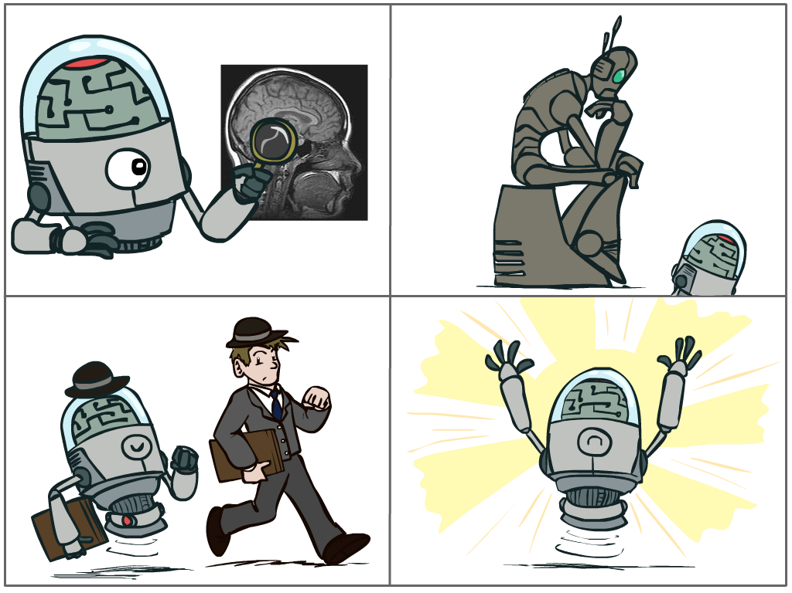
Artificial Intelligence
The science of making machines that:
Think like people
Think rationally
Act like people
Act rationally
Notes:
Four considerations.
Top left: natural intelligence -- Think like people --- cognitive science, neuroscience. Are human brains perfect? What if we could think rationally.
Think rationally – correct thought process -- long tradition dating back to Aristotle --- this is how to think so that you don’t make mistakes; but not a winner, because difficult to encode how to think / especially in the face of unknowns/uncertainty, and in the end it’s not about how you think, it’s about how you end up acting
Some aspect of correctness
Bottom left: who cares about how they think? act like people --- actually very early definition, dating back to Alan Turing --- Turing test; problem to do really well you start focusing on things like don’t answer too quickly what the square root of 1412 is, don’t spell too well, and make sure you have a favorite movie etc. So it wasn’t really leading us to build intelligence
Are people rational
40

Slide 41
Rational Decisions
We’ll use the term rational in a very specific, technical way:
Rational: maximally achieving pre-defined goals
Rationality only concerns what decisions are made
(not the thought process behind them)
Goals are expressed in terms of the utility of outcomes
Being rational means maximizing your expected utility
A better title for this course would be:
Computational Rationality
Notes:
Not about building machines that don’t get angry
Example of utilities. 10 for A, 1 for each Friday with friends
People being rational.

Slide 42
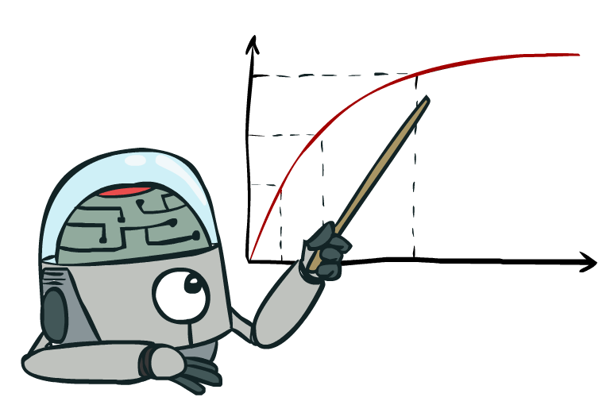
Maximize Your
Expected Utility
Notes:
Distill course to maximize expected utility.
Make these 4 better
42

Slide 43
Maximize Your
Expected Utility
Notes:
Consequences of an action, context, other actors around
Convex Opt
43

Slide 44
Maximize Your
Expected Utility
Notes:
What is a utility?
Related to -
Utilitarianism (Consequntialism) – Jeremy Bentham
Utility rather than values, could be
Virtue Ethics – Aristotle
Deontology (Duty based ethics)
44

Slide 45
Maximize Your
Expected Utility
Notes:
rationality not about being successful – doing the right thing on average.
45

Slide 46
Maximize Your
Expected Utility
Notes:
Very end – who is your? How do you get that?
Does the agent serve us? Important when figuring out if the agent is helping - many cues from philosophy here.
What is an agent that is good about acting for itself? Humans!
Replicating the brain would be an AI, right?
46

Slide 47
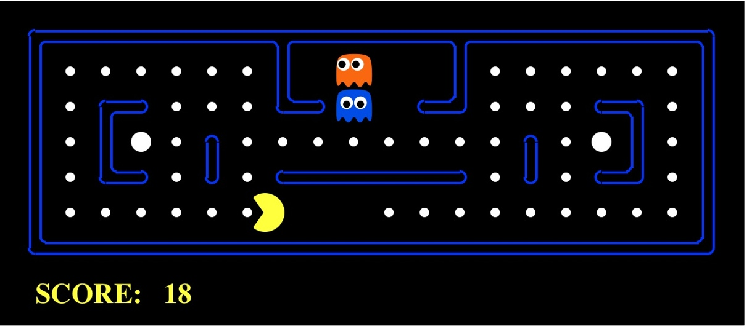
AI as Designing Rational Agents
An agent is an entity that perceives and acts.
A rational agent selects actions that maximize its expected utility.
Characteristics of the sensors, actuators, and environment dictate techniques for selecting rational actions
This course is about:
General AI techniques for many problem types
Learning to choose and apply the technique appropriate for each problem
Sensors
Percepts
Agent
Environment
?
Actuators
Actions

Slide 48

Pac-Man as an Agent
Agent
Environment
Sensors
Percepts
?
Actuators
Actions
Notes:
48

Slide 49
Agents and environments
Agent
Environment
Sensors
Percepts
?
Actuators
Actions
An agent perceives its environment through sensors and acts upon it through actuators (or effectors, depending on whom you ask)

Slide 50
Agents and environments
Agent
Environment
Sensors
Percepts
?
Actuators
Actions
Are humans agents?
Yes!
Sensors = vision, audio, touch, smell, taste, proprioception
Actuators = muscles, secretions, changing brain state

Slide 51
Agents and environments
Agent
Environment
Sensors
Percepts
?
Actuators
Actions
Are pocket calculators agents?
Yes!
Sensors = key state sensors
Actuators = digit display

Slide 52
Agents and environments
Agent
Environment
Sensors
Percepts
?
Actuators
Actions
AI is more interested in agents with large computational resources and environments that require nontrivial decision making

Slide 53
Agent functions
The agent function maps from percept histories to actions:
f : P* → A
I.e., the agent’s actual response to any sequence of percepts
Percept
NEXT
NEXT
NEXT
NEXT
Action
LEFT
LEFT
DROP
RIGHT
Notes:
Is there any reason to pay attention to more than just the current percept?
No – the correct decision depends only on the current percept because the world is fully observable!

Slide 54
Agent programs
The agent program l runs on some machine M to implement f :
f = Agent(l,M)
Real machines have limited speed and memory, introducing delay, so agent function f depends on M as well as l
Percept
NEXT
NEXT
NEXT
NEXT
Action
NOOP
NOOP
NOOP
LEFT

Slide 55
Agent functions and agent programs
Can every agent function be implemented by some agent program?
No! Consider agent for halting problems, NP-hard problems, chess with a slow PC

Slide 56
Example: Vacuum world
Percepts: [location,status], e.g., [A,Dirty]
Actions: Left, Right, Suck, NoOp

Slide 57
Vacuum cleaner agent
Agent function
Agent program
Percept sequence | Action
[A, Clean] | Right
[A, Dirty] | Suck
[B, Clean] | Left
[B, Dirty] | Suck
[A, Clean], [B, Clean] | Left
[A, Clean], [B, Dirty] | Suck
etc | etc
function Reflex-Vacuum-Agent([location, status])
returns an action
if status = Dirty then return Suck
else if location = A then return Right
else if location = B then return Left
What is the right agent function?
Can it be implemented by a small agent program?

Slide 58
Rationality
Fixed performance measure evaluates the environment sequence
one point per square cleaned up?
NO! Rewards an agent who dumps dirt and cleans it up
one point per clean square per time step, for t = 1,…,T
A rational agent chooses whichever action maximizes the expected value of the performance measure
given the percept sequence to date and prior knowledge of environment
Does Reflex-Vacuum-Agent implement a rational agent function?
Yes, if movement is free, or new dirt arrives frequently
Notes:
The dirt-dumping problem is an example of the King Midas problem – mis-specifying the objective

Slide 59
Rationality, contd.
Are rational agents omniscient?
No – they are limited by the available percepts
Are rational agents clairvoyant?
No – they may lack knowledge of the environment dynamics
Do rational agents explore and learn?
Yes – in unknown environments these are essential
Do rational agents make mistakes?
No – but their actions may be unsuccessful
Are rational agents autonomous (i.e., transcend initial program)?
Yes – as they learn, their behavior depends more on their own experience

Slide 60
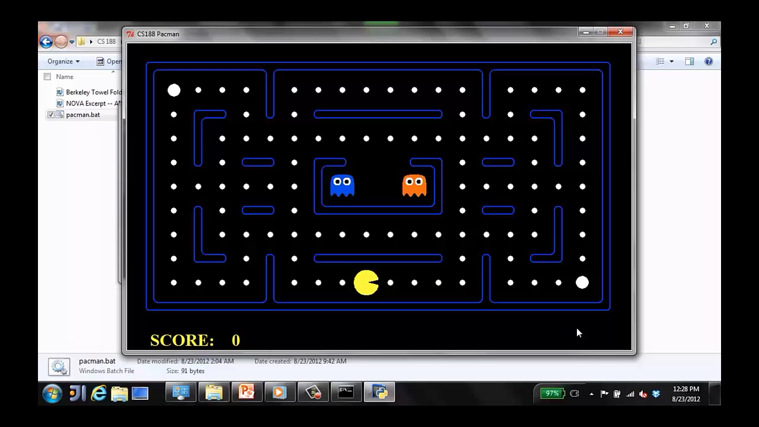
A human agent in Pacman

Slide 61
The task environment - PEAS
Performance measure
-1 per step; + 10 food; +500 win; -500 die; +200 hit scared ghost
Environment
Pacman dynamics (incl ghost behavior)
Actuators
Left Right Up Down
Sensors
Entire state is visible

Slide 62
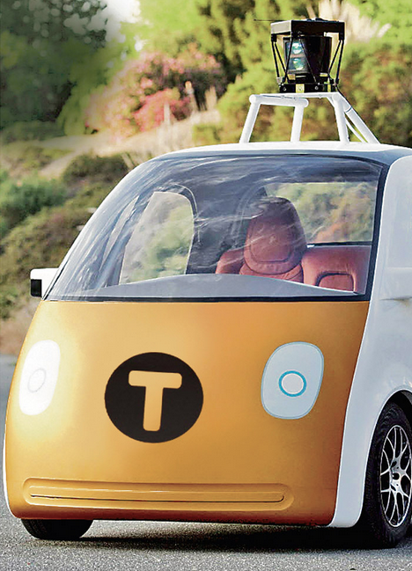
PEAS: Automated taxi
Performance measure
Income, happy customer, vehicle costs, fines, insurance premiums
Environment
Streets, other drivers, customers, weather, police…
Actuators
Steering, brake, gas, display/speaker
Sensors
Camera, radar, accelerometer, engine sensors, microphone, GPS
Image: http://nypost.com/2014/06/21/how-google-might-put-taxi-drivers-out-of-business/

Slide 63
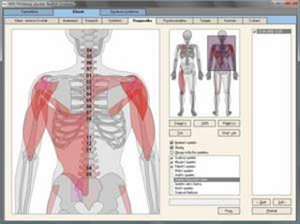
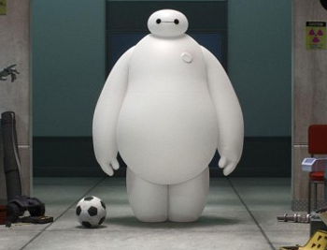
PEAS: Medical diagnosis system
Performance measure
Patient health, cost, reputation
Environment
Patients, medical staff, Lab
Actuators
Screen display, printer
Sensors
Keyboard/mouse

Slide 64
Task Environment
Before we design an intelligent agent, we must specify its “task environment”:
PEAS:
Performance measure
Environment
Actuators
Sensors

Slide 65
Environment types
Single Agent | Multi Agent
Single Vacuum Cleaner | Two Vacuum Cleaner
Fully Observable | Partially Observable
An agent's sensors give it access to the complete state of the environment at each point in time. | Noisy and inaccurate sensors or because parts of the state are simply missing from the sensor data
Agent need not maintain any internal state to keep track of the world | Agent need maintain all internal state to keep track of the world
Vacuum agent with max dirt sensor can tell whether there is dirt in other room. | Vacuum agent with only a local dirt sensor cannot tell whether there is dirt in other room.
Deterministic | Stochastic
The next state of the environment is completely determined by the current state and the action executed by the agent. | Other wise Stochastic
Vacuum Cleaner world | Taxi Driving

Slide 66
Environment types
Episodic | Sequential
The next episode does not depend on the actions taken in previous episodes. | Current decision could affect all future decisions
Spot defective parts on an assembly line | Chess and taxi driving
Discrete | Continuous
A limited number of distinct state, clearly defined percepts and actions | state, percept and action change w.r.t. time.
Chess | Taxi driving
Static | Dynamic
The environment is unchanged while an agent is deliberating | Environment can change while an agent is deliberating
Vacuum Cleaner world | Taxi driving

Slide 67
Environment types
 | Pacman | Backgammon | Diagnosis | Taxi
Fully or partially observable
Single-agent or multiagent
Deterministic or stochastic
Static or dynamic
Discrete or continuous
Known physics?
Known perf. measure?

Slide 68
task environm. | observable | determ./ stochastic | episodic/ sequential | static/ dynamic | discrete/ continuous | agents
crossword puzzle
chess with clock
poker
taxi driving
medical diagnosis
image analysis
partpicking robot
refinery controller
interact. Eng. tutor

Slide 69
task environm. | observable | determ./ stochastic | episodic/ sequential | static/ dynamic | discrete/ continuous | agents
crossword puzzle | fully | determ. | sequential | static | discrete | single
chess with clock
poker
taxi driving
medical diagnosis
image analysis
partpicking robot
refinery controller
interact. Eng. tutor

Slide 70
task environm. | observable | determ./ stochastic | episodic/ sequential | static/ dynamic | discrete/ continuous | agents
crossword puzzle | fully | determ. | sequential | static | discrete | single
chess with clock | fully | strategic | sequential | semi | discrete | multi
poker
taxi driving
medical diagnosis
image analysis
partpicking robot
refinery controller
interact. Eng. tutor

Slide 71
task environm. | observable | determ./ stochastic | episodic/ sequential | static/ dynamic | discrete/ continuous | agents
crossword puzzle | fully | determ. | sequential | static | discrete | single
chess with clock | fully | strategic | sequential | semi | discrete | multi
poker | partial | stochastic | sequential | static | discrete | multi
taxi driving
medical diagnosis
image analysis
partpicking robot
refinery controller
interact. Eng. tutor

Slide 72
task environm. | observable | determ./ stochastic | episodic/ sequential | static/ dynamic | discrete/ continuous | agents
crossword puzzle | fully | determ. | sequential | static | discrete | single
chess with clock | fully | strategic | sequential | semi | discrete | multi
poker | partial | stochastic | sequential | static | discrete | multi
taxi driving | partial | stochastic | sequential | dynamic | continuous | multi
medical diagnosis
image analysis
partpicking robot
refinery controller
interact. Eng. tutor

Slide 73
task environm. | observable | determ./ stochastic | episodic/ sequential | static/ dynamic | discrete/ continuous | agents
crossword puzzle | fully | determ. | sequential | static | discrete | single
chess with clock | fully | strategic | sequential | semi | discrete | multi
poker | partial | stochastic | sequential | static | discrete | multi
taxi driving | partial | stochastic | sequential | dynamic | continuous | multi
medical diagnosis | partial | stochastic | sequential | dynamic | continuous | single
image analysis
partpicking robot
refinery controller
interact. Eng. tutor

Slide 74
task environm. | observable | determ./ stochastic | episodic/ sequential | static/ dynamic | discrete/ continuous | agents
crossword puzzle | fully | determ. | sequential | static | discrete | single
chess with clock | fully | strategic | sequential | semi | discrete | multi
poker | partial | stochastic | sequential | static | discrete | multi
taxi driving | partial | stochastic | sequential | dynamic | continuous | multi
medical diagnosis | partial | stochastic | sequential | dynamic | continuous | single
image analysis | fully | determ. | episodic | semi | continuous | single
partpicking robot
refinery controller
interact. Eng. tutor

Slide 75
task environm. | observable | determ./ stochastic | episodic/ sequential | static/ dynamic | discrete/ continuous | agents
crossword puzzle | fully | determ. | sequential | static | discrete | single
chess with clock | fully | strategic | sequential | semi | discrete | multi
poker | partial | stochastic | sequential | static | discrete | multi
taxi driving | partial | stochastic | sequential | dynamic | continuous | multi
medical diagnosis | partial | stochastic | sequential | dynamic | continuous | single
image analysis | fully | determ. | episodic | semi | continuous | single
partpicking robot | partial | stochastic | episodic | dynamic | continuous | single
refinery controller | partial | stochastic | sequential | dynamic | continuous | single
interact. Eng. tutor | partial | stochastic | sequential | dynamic | discrete | multi

Slide 76
Agent design
The environment type largely determines the agent design
Partially observable => agent requires memory (internal state)
Stochastic => agent may have to prepare for contingencies
Multi-agent => agent may need to behave randomly
Static => agent has time to compute a rational decision
Continuous time => continuously operating controller
Unknown physics => need for exploration
Unknown perf. measure => observe/interact with human principal

Slide 77
Agent types
In order of increasing generality and complexity
Simple reflex agents
Reflex agents with state
Goal-based agents
Utility-based agents

Slide 78
Simple reflex agents

Slide 79
Example: Vacuum world
Percept sequence | Action
[A,Clean] | Right
[A,Dirty] | Suck
[B,Clean] | Left
[B,Dirty] | Suck
[A,Clean],[B,Clean] | Left
[A,Clean],[B,Dirty] | Suck
etc | etc

Slide 80
Pacman agent in Python
class GoWestAgent(Agent):
def getAction(self, percept):
if Directions.WEST in percept.getLegalPacmanActions():
return Directions.WEST
else:
return Directions.STOP

Slide 81
Pacman agent contd.
Can we (in principle) extend this reflex agent to behave well in all standard Pacman environments?
No – Pacman is not quite fully observable (power pellet duration)
Otherwise, yes – we can (in principle) make a lookup table…..
Notes:
106 locations so 106^3 * 2^106 (ignoring power pellet stuff) =~ 10^38 states
Worse if the map is not fixed – all possible physics? No – can simply say 3^150 or whatever

Slide 82
Reflex agents with state

Slide 83
Example: Vacuum world
Percept sequence | Action
[A,Clean] | Right
[A,Dirty] | Suck
[B,Clean] | Left
[B,Dirty] | Suck
[A,Clean],[B,Clean] | No-Op
[A,Clean],[B,Dirty] | Suck
etc | etc

Slide 84
Goal-based agents
Notes:
Act to achieve a goal
Pro: use goal to index into actions that might achieve it, eg “Have milk” -> “buy milk”
Con: cannot handle tradeoffs among goals, failure probability etc.

Slide 85

Example: Path Finding

Slide 86
Utility-based agents
Notes:
Utility is a numeric scale
Pro: can compute expected values for actions, handle tradeoffs and uncertainty
Con: cannot (easily) index into actions

Slide 87
Example: Pac-Man
Notes:
87

Slide 88
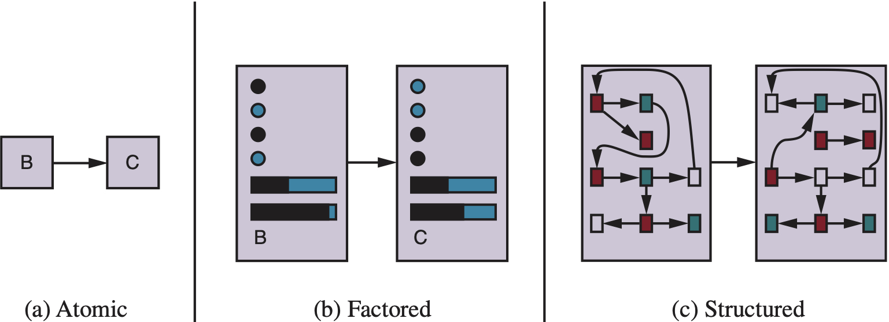
Spectrum of representations

Slide 89
Applied Areas of AI
Logical AI
Search
Planning
Artificial Neural Network
Natural language processing
Computer vision
Pattern recognition
Ontology the study of the kinds of things that exist.
Knowledge representation
Inference From some facts, others can be inferred.
Epistemology This is a study of the kinds of knowledge that are required for solving problems in the world.
Reasoning
Learning
Games
Artificial life / worlds
Emotions
Knowledge Management
Socialization/communication

Slide 90
Summary
An agent interacts with an environment through sensors and actuators
The agent function, implemented by an agent program running on a machine, describes what the agent does in all circumstances
Rational agents choose actions that maximize their expected utility
PEAS descriptions define task environments; precise PEAS specifications are essential and strongly influence agent designs
More difficult environments require more complex agent designs and more sophisticated representations

